Slide 1

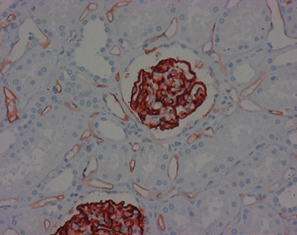
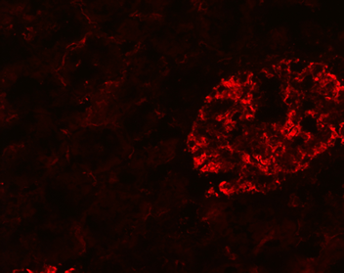
ReliaTech GmbH
Mouse anti-human Podocalyxin (#GB6D9)
(Cat# 101-M142)
Figure 1: Staining of the podocytes in the glomerulus and the tubulointerstitial blood vessels (paraffin-embedded tissue-sections fixed in formalin) with anti-human Podocalyxin [Cat# 101-M142].
Figure 2: Immunofluorescence staining of the podocytes in the glomerulus and the tubulointerstitial blood vessels (paraffin-embedded tissue-sections fixed in formalin) with anti-human Podocalyxin [Cat# 101-M142].
http://www.reliatech.de / orders@reliatech.de

